Slide 1
Functional Testing services for HDFC Life
Siddharth Mirani
Dated 19th December 2017

Slide 2
Outline
1
Executive Summary
2
Scope & Responsibilities
3
Deliverables
4
Commercials

Slide 3
Executive Summary
Planit is pleased to submit a proposal for HDFC Life for their functional testing requirements of Maturity functionality for ULIP based 49
products
Our solutions are delivered on the following foundational capabilities:
People- Experienced team backed by thought leaders in software testing
Process- Standardized Planit methodologies backed by domain expertise
Tools- Leverage open source tools and frameworks to deliver cost effective solutions
Planit Proposes to set up an Functional testing team of Functional Testing Engineer’s at HDFC Life premises in Mumbai & Planit office in
Hyderabad for a period of 2 months based on the application scope walkthrough and the effort estimation done by Planit team & HDFC life
for the application for the maturity stage testing for ULIP based 49 products
Based on the understanding we had from the discussions along with HDFC Life team Planit is pleased to propose a T&M based model for a period of 2 months. This can be further extended based on mutual agreement between HDFC Life & Planit for other products to be tested
Planit would like to offer a model wherein Planit Sr. Test Engineers will handle the Functional Testing onsite and a team Test Engineers
offshore & creation of functional test cases
All the resources i.e. onshore & offshore will managed by a Planit Team lead to ensure efficient and smooth delivery within the stipulated timeline
Planit has valid credentials in the functional, Test Automation space and have delivered significant cost benefits ensuring a higher TAT for application releases

Slide 4
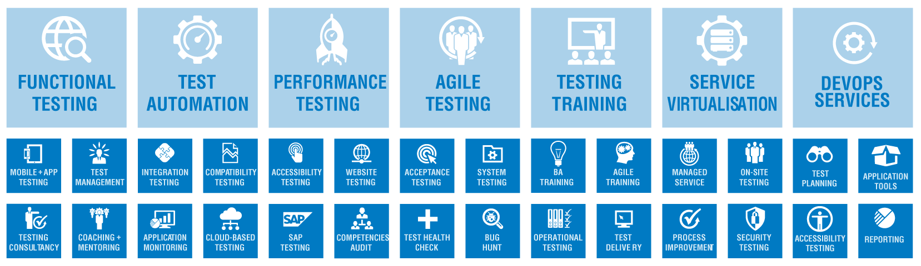
Our Portfolio of Services offered

Slide 5
Scope & Responsibilities for HDFC Life & Planit
Scope
HDFC Life would like us to complete testing for Maturity claims for 49 ULIP Products
A tentative timeline of completion of testing activity within a duration of 1 month based on the effort estimation done by Planit & HDFC Life Team
Currently the maturity functionality of these products has not been tested
Complete functionality check with varied test scenario’s to be created by Planit and tested across Life Asia using valid test data
Planit will conduct one round of testing and report bugs to the development team and re-test the application ensure a quality release of the application into production
HDFC Life Responsibilities
Providing the test infrastructure and necessary infra requirements i.e. Desktops and seats etc for Planit team to come onsite and complete the project
Remote access to be provided to Planit HYD Team and ensure smooth and stable environment to conduct the testing activity
Detailed walkthrough of the application and required Knowledge transfer
HDFC Life will support Planit in creation/ making available of Test Data required for testing

Slide 6
Scope & Responsibilities for HDFC Life & Planit
Planit Responsibilities
Testing the product platform under the Customer guidance across functional areas with the ultimate objective of better quality product
Logging of defects identified and sign off on the activities completed from the stakeholders
With our expertise and the discussions we have had with HDFC Life team, Planit will try to leverage automation Test data generator & which would be the right fit
Planit will do one round of Functional Testing and second round of testing for bug fixes which is assumed to be not more than 30% of the total data
Build an intelligent Test Scenario's which provides maximum coverage and ensures the product is bug free while releasing it in production

Slide 7



Planit Functional Testing Team
Test Setup for Testing
Test artifacts creation, SIT
Testing of 49 products across
Life Asia
Eliminate people dependent processes, manual processes, to manage future scalability towards faster testing
HDFC Life Maturity Stage Testing
Defect Reports
Test Reports
Risk Coverage
Requirements Coverage Analysis
Deliverables
Planit Testing Team
HDFC Life Team
Requirement doc’s, KT’s, UAT and test artifact review
Test artefacts creation, SIT

Slide 8
Commercials
Planit will Support HDFC Life with a suitable team of 1 Test Lead & 3 Test Engineers( Onsite) and 2 Test Engineers( offshore –
Billable resource only one) for a period of 2 months considering the effort estimation done by Planit team and along with HDFC Life
towards completion of this project
Based on the requirement and changes coming in from a scope perspective the project would be extended towards other product testing
The below pricing is considering for a period of 2 months of duration as per the effort estimation done by Planit team
considering the walkthrough of the application given and recommendations given by HDFC Life team
The team would work onsite from HDFC Life Mumbai premises & Planit office Hyderabad
Planit would bill a monthly cost for the project i.e. INR 335,000 + statutory taxes. Planit will need HDFC Life to raise a PO for
INR 670,000+ taxes for a period of two months
Any extension in the project beyond the timelines would be charged on T&M basis as per the below rate card
Payment period is net 15 days from the invoice date
Any extensions beyond Planit’s control would be charged on T&M basis
Purchase Order has to be issued in name of Planit Testing India Pvt Ltd
No of resource | Designation | Experience | Rate per month basis INR | Total Monthly Cost
1 | One Functional Test Lead( Onsite) | 4-6 | 108000 | 108000
3 | Test Engineer (Onsite) | 1-2 | 58000 | 174000
2 | Test Engineer (Offshore) | 1-2 | 53000 | 53000
These commercials are for our professional fees. These do not include any costs related with procurement of tools and the associated infrastructure.

Slide 9
Commercials
Other Terms
Planit team would work 5 days a week as per HDFC Life timing (i.e.9 hours of standard work hours) and holidays will be followed as per HDFC Life calendar and our resources would not be providing services on Saturdays & Sundays
Planit team would be operating from HDFC Life facilities in Mumbai . HDFC Life would make all arrangements for providing seating, computing infrastructure and other amenities for the Planit team
Any travel if required will be charged additionally on actuals
If any resource resigns from Planit, under such circumstances it will be Planit responsibility to provide a replacement at no additional cost and it will be Planit responsibility to take care of the Knowledge transfer and transition
Any significant over time above this would be chargeable at pro rata basis considering based on agreed amount between HDFC Life & Planit
Planit resource would be eligible for 1 day leave per month, which would be billable and the will also be eligible for all the standard client holidays
TERM & TERMINATION
The Agreement commences on the Effective Date and continues until terminated by either Party at any time upon thirty (30) days’ prior written notice to the other Party; provided that all the existing terms and conditions in the proposal as mentioned above shall remain in effect

Slide 10
Your Feedback is Welcome
Siddharth Mirani :+ 91-9920126163
siddharthm@planittesting.com

